Slide 1


Churn Prediction For Banking Customers
Abhinav Mishra
Sunil Hule

Slide 2

Objective “Our goal is to identify patterns that leads to potential churn among banking customers and develop a predictive model that can accurately forecast the likelihood of customer attrition."

Slide 3

Dataset Information: RowNumber: This is the index for each record in the dataset CustomerId: A unique identifier for each customer. Surname: The last name of the customer. CreditScore: The credit score of the customer, which is a numerical measure of their creditworthiness. Geography: The country or region where the customer is located (e.g., France, Spain, Germany). Gender: The gender of the customer (e.g., Male or Female). Age: The age of the customer. Tenure: The number of years the customer has been with the bank. Balance: The account balance of the customer. NumOfProducts: The number of bank products the customer is using (e.g., savings accounts, loans, etc.). HasCrCard: Whether the customer has a credit card (1 for yes, 0 for no). IsActiveMember: Whether the customer is an active member (1 for yes, 0 for no). EstimatedSalary: The estimated annual salary of the customer. Exited: It indicates whether the customer has churned or not (1 for churned, 0 for not churned).

Slide 4
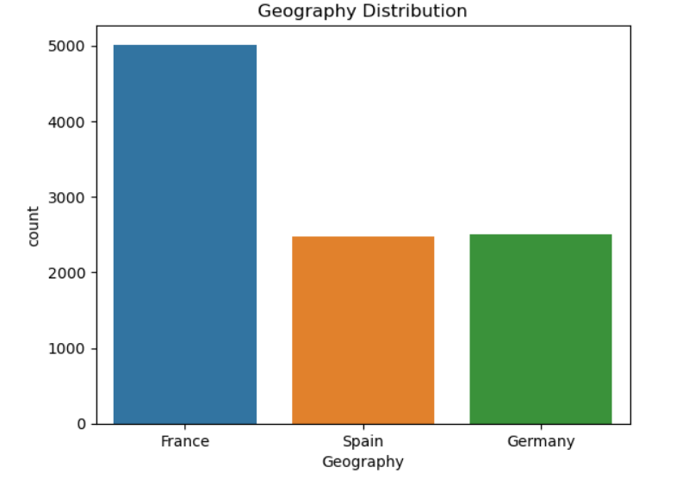
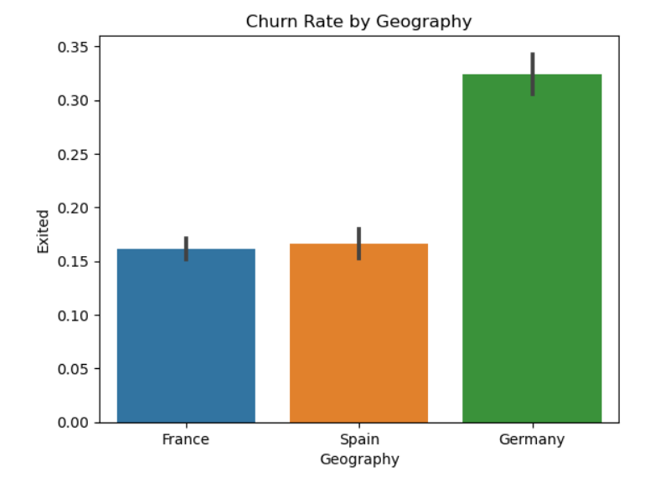
Data Analysis
Distribution of “Geography” Churn Percentage w.r.t. “Geography”

Slide 5
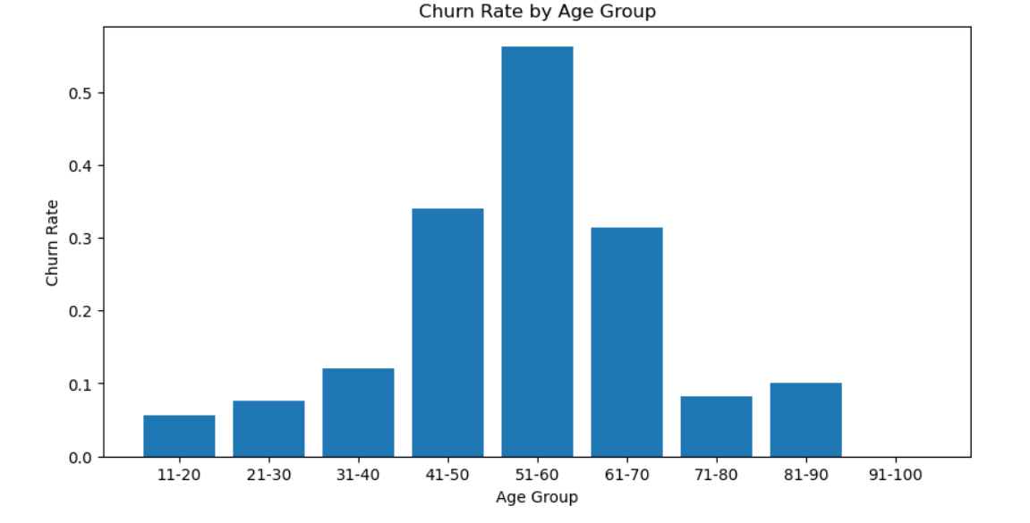
Churn Rate By “Age Group”

Slide 6
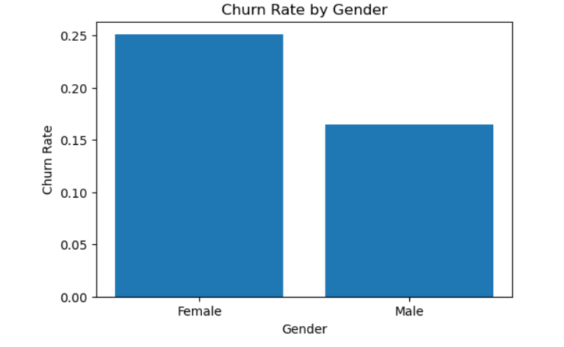
Churn Rate By “Gender”

Slide 7
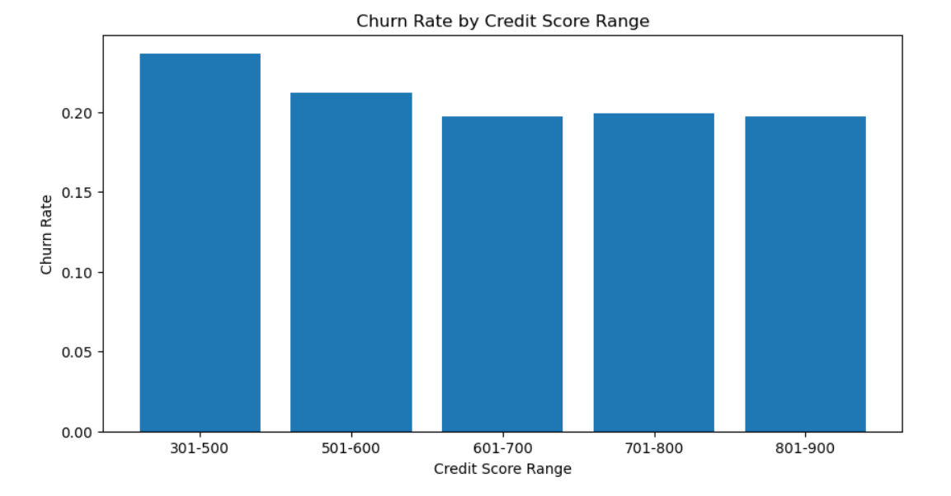
Churn Rate By “Credit Score”

Slide 8
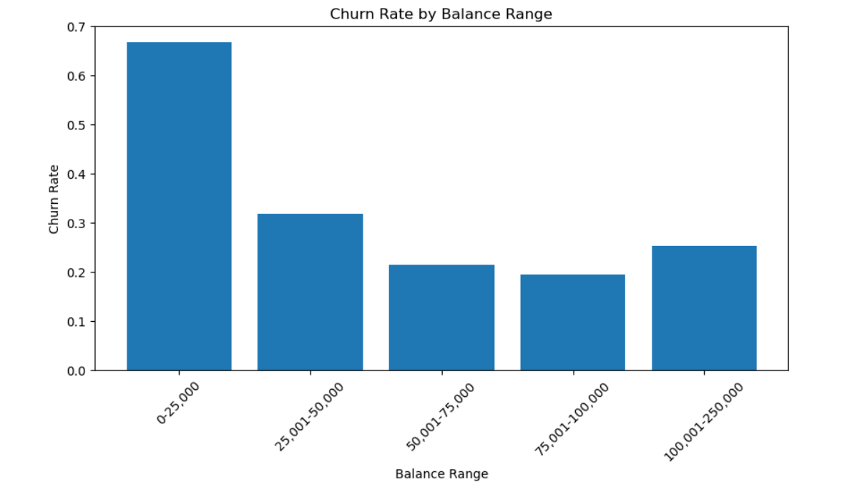
Churn rate By “Balance Range”

Slide 9
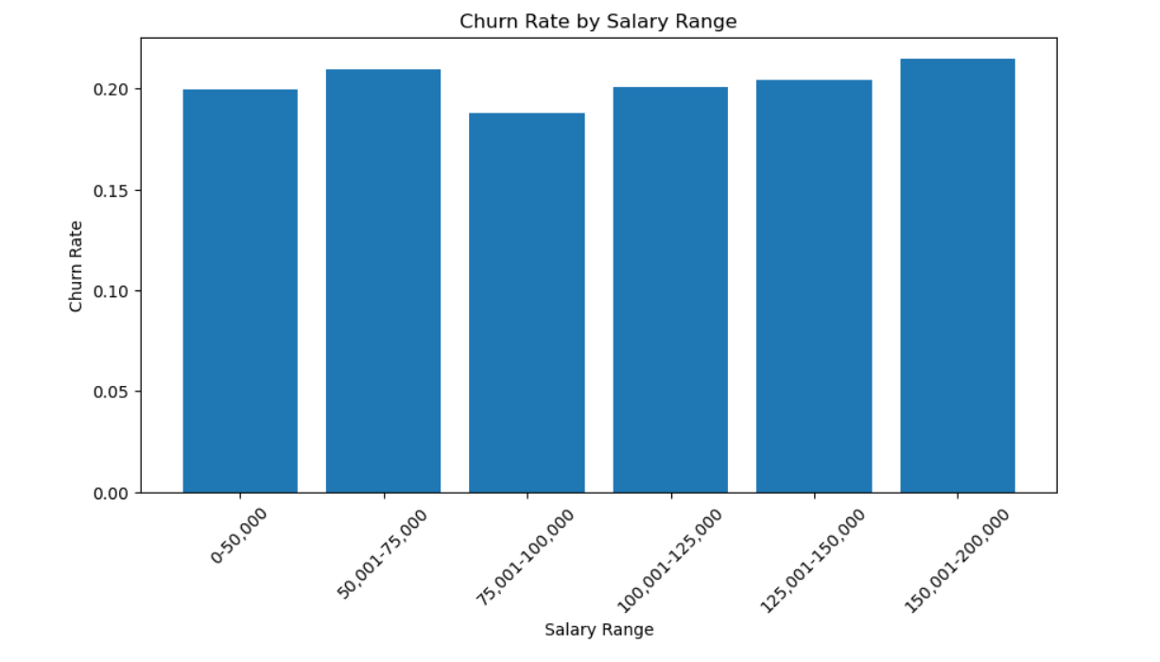
Churn Rate By “Salary Range”

Slide 10

Findings From EDA • France has the highest number of bank customers, followed by Germany and Spain. But churn rate is highest in Germany (32.44%), followed by France (16.15%), and Spain (16.67%). • Customers aged 51-60 have the highest churn rate at 56.21%. Churn rates are relatively lower for customers in the 0-30, and 71-80 age groups. • Churn rates are higher for female customers (25.07%) compared to male customers (16.46%). • Churn rates decrease as credit scores increase, with the lowest churn rate at 19.69% for customers with a credit score of 601-700. • Customers with a balance range of 0-25,000 have the highest churn rate (66.67%). Churn rates decrease as balance increases, with the lowest churn rate at 19.40% for customers with a balance of 75,001-100,000. • Customers with and without a credit card show similar churn rates, with slightly higher churn for those without (20.81% vs. 20.18%) • Churn rates are relatively consistent across salary ranges, with the highest churn rate at 21.47% for customers with a salary between 150,001-200,000.

Slide 11

Models

Slide 12
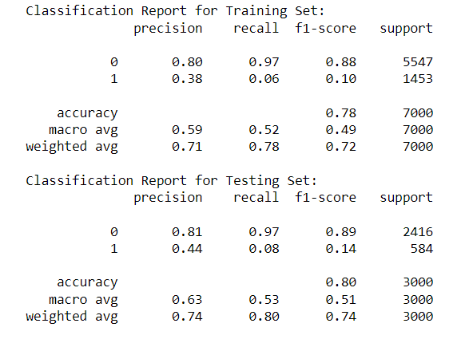
Logistic Regression

Slide 13
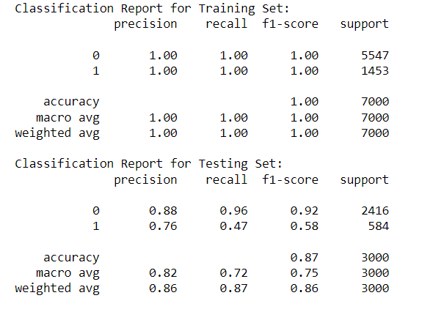
Random Forest

Slide 14
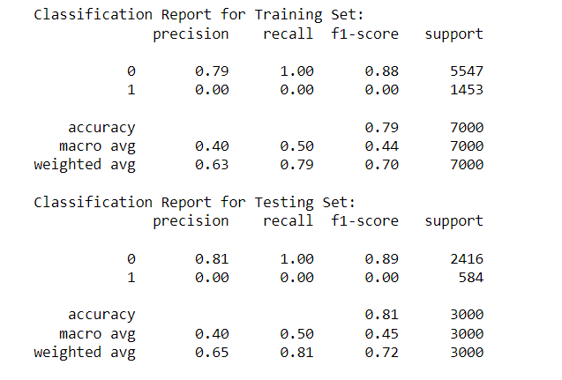
Suport Vector Machine

Slide 15
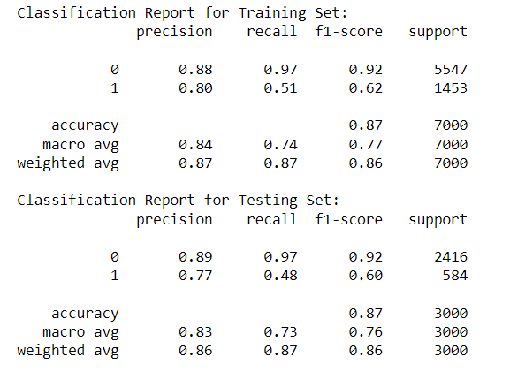
Gradient Boosting Classifier

Slide 16
Conclusion
The analysis included several classification models. Gradient Boosting seem to be more suitable for predicting churn with great accuracy while avoiding overfitting. Random Forest shows promising results as well but the performance on training set was too high which usually is not able to generalize well when it comes to new and unseen data. Support Vector Classification, on the other hand, performed same as Logistic Regression that gave lower accuracy on both testing and training set

Slide 17
Thank You

